Slide 1
RSA algorithm to encrypt and decrypt the data
Notes:
<number>

Slide 2
OBJECTIVE
To implement RSA Algorithm to Encrypt and Decrypt data.
<number>
Notes:
<number>

Slide 3
INTRODUCTION
Internet Security is becoming more important everyday.
Cryptography is the heart of security.
In order to protect our data, encryption is done at sender side and decryption is carried out at receiver’s side.
<number>

Slide 4
INTRODUCTION
SECURITY ASPECTS.
AUTHENTICATION.
Authentication provides the identification of the originator.
It confirms to the receiver that the data received has been sent only by an identified and verified sender.
CONFIDENTIALITY.
Confidentiality is the fundamental security service provided by cryptography.
It is a security service that keeps the information confidential from an unauthorized person.
It is sometimes referred to as privacy or secrecy.
NONREPUDIATION.
It is a security service that ensures that an entity cannot refuse the ownership of a previous commitment or an action.
It is an assurance that the original creator of the data cannot deny the creation or transmission of the said data to a recipient or third party.
DATA INTEGRITY.
It is security service that deals with identifying any alteration to the data.
The data may get modified by an unauthorized entity intentionally or accidently.
Integrity service confirms that whether data is intact or not since it was last created, transmitted, or stored by an authorized user.
<number>

Slide 5
INTRODUCTION
HASHING.
Creating a miniature version of a message instead of original message.
AUTHENTICATION OF PEOPLE.
KEY MANAGEMENT
<number>

Slide 6
INTRODUCTION
SECURITY AND INTERNET MODEL.
OSI model provided encryption/ decryption services in the presentation layer which does not exists in the internet model.
At which layer security need to be implemented in internet model?
Security breach can happen in any of the five layers.
At physical layer, an intruder can wiretap into the transmission media and read or alter a sequence of bits.
At data link layer, frames can be captured and read or altered.
Example: LAN, where transmission is broadcast and every station receives a copy of frame.
At the network layer, an IP datagram can be removed, altered, or inserted into the network.
At the transport layer, a user datagram or a segment can be captured or altered.
Finally, at application layer, the whole message can be altered or read.
<number>

Slide 7
INTRODUCTION
Concerns need be addressed before adding security to the Internet.
Security is more effective in which layer?
Security is easier to provide in which layer?
Security at one level, is that enough?
<number>

Slide 8
Cryptography
Cryptography in Greek means “Secret Writing”.
It is an art and science of transforming messages to make them secure and immune to attacks.
<number>

Slide 9
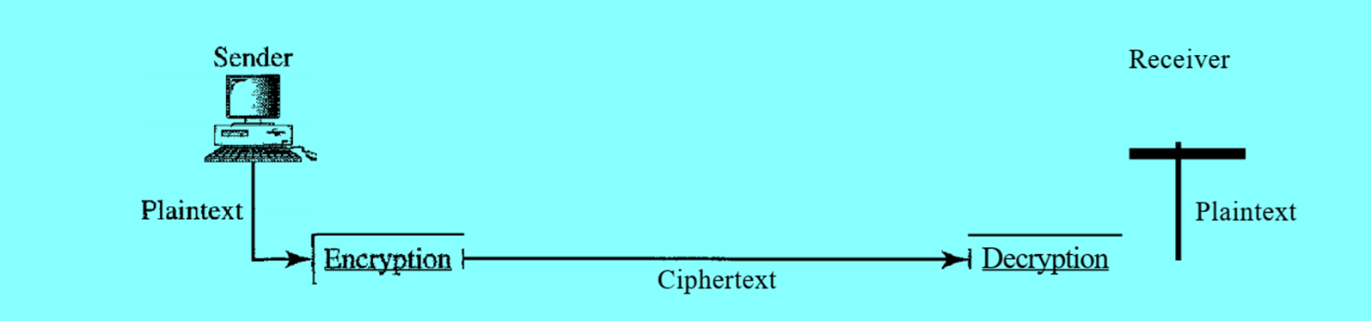
Cryptography components BLOCK DIAGRAM
<number>

Slide 10
Cryptography components
The original message, before being transformed, is called plaintext.
After the message is transformed, it is called ciphertext.
An encryption algorithm transforms the plaintext to ciphertext;
A decryption algorithm transforms the ciphertext back to plaintext.
The sender uses an encryption algorithm and the receiver uses a decryption algorithm.
The term cipher refers to encryption/ decryption algorithms.
A key is a number(value) that the cipher, as an algorithm, operates on.
<number>

Slide 11
Encryption and decryption
To encrypt a message, an encryption algorithm, encryption key and plaintext is required.
To decrypt a message, a decryption algorithm, a decryption key and ciphertext is required.
The encryption and decryption algorithms are public; anyone can access them.
The keys are secret; they need to be protected.
<number>

Slide 12
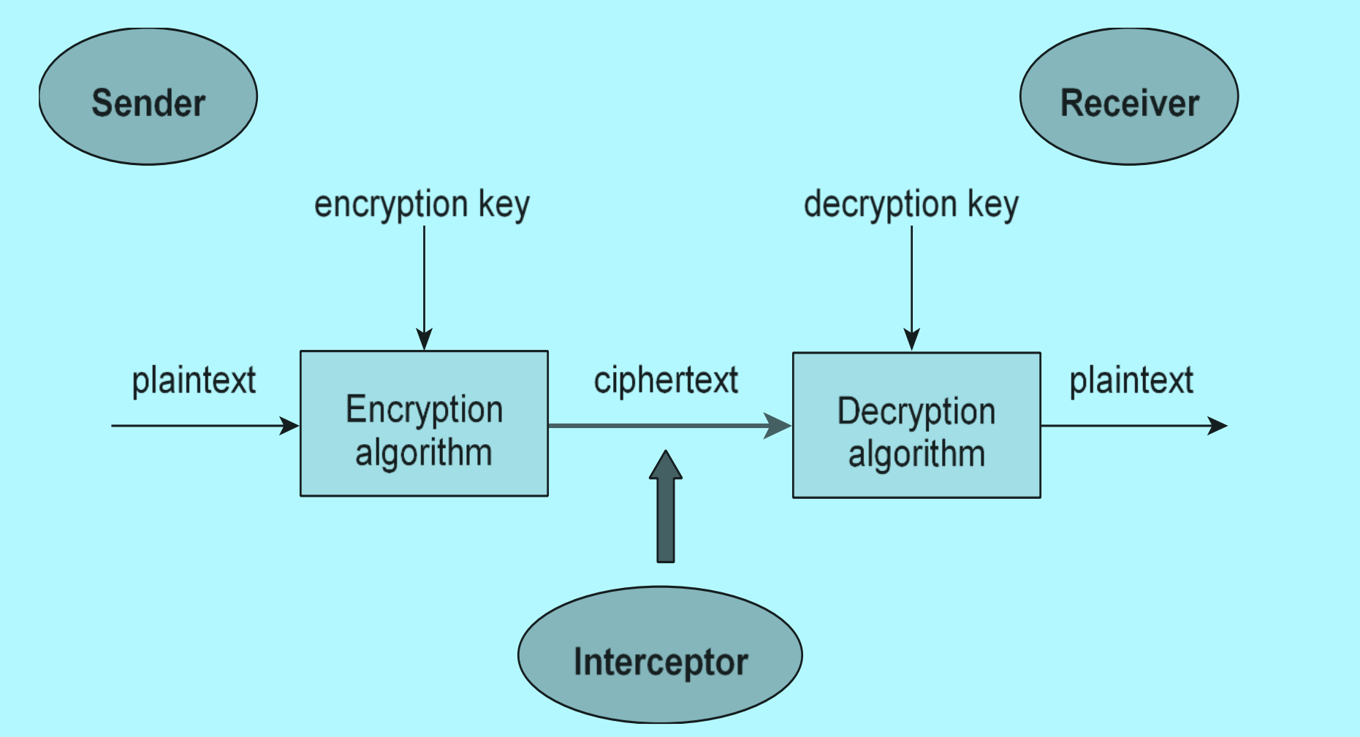
Encryption and decryption BLOCK DIAGRAM
<number>

Slide 13
TYPES OF CRYPTOGRAPHY
CRYPTOGRAPHY
SECRET-KEY (SYMMETRIC KEY)
PUBLIC KEY(ASYMMETRIC-KEY)
<number>

Slide 14
SYMMETRIC KEY(SECRET-KEY) CRYPTOGRAPHY
In symmetric key cryptography, the same key is used by both sender and receiver.
Sender uses this key and an encryption algorithm to encrypt data;
Receiver uses the same key and a decryption algorithm to decrypt data.
The key is shared.
<number>

Slide 15
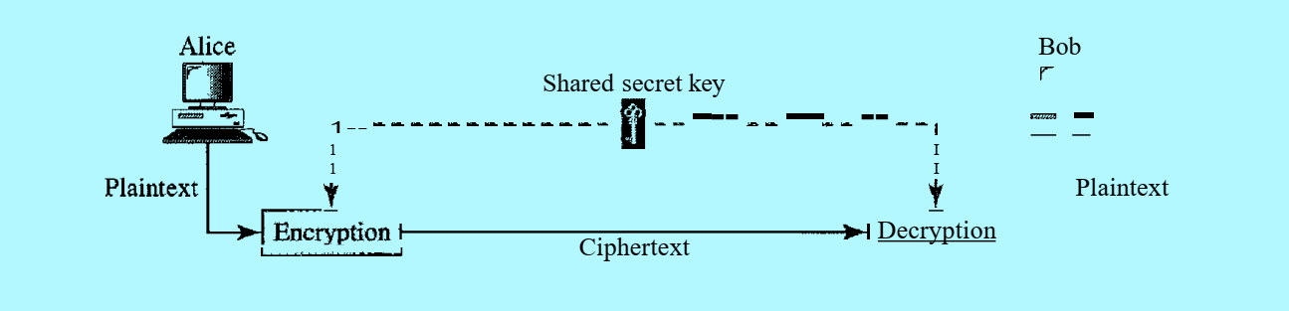
SYMMETRIC KEY CRYPTOGRAPHY block diagram
<number>

Slide 16
Differences between symmetric-key and asymmetric-key cryptography
Asymmetric-key
Two different keys are used for encryption and decryption: Public key and Private key.
More efficient for short messages.
Private key is kept by receiver, public key is announced to the public.
Overcomes the drawback of symmetric-key cryptography, by reducing the number of keys to 2N.
Complex algorithms.
Ex: RSA algorithm.
Symmetric-key
Same key is used for encryption and decryption.
Used for long messages.
Each pair of users must have a unique symmetric key: for ‘N’ users there need to be [N(N-1)/2] symmetric keys.
Key distribution between sender and receiver is difficult.
Simple algorithms.
Ex: DES, Triple DES.
<number>

Slide 17
ASYMMETRIC KEY (PUBLIC-KEY)CRYPTOGRAPHY
In public-key cryptography, there are two key: a private key and a public key.
The public key is used for encryption and private key for decryption.
Advantages:
Removes the restriction of a shared symmetric key between two entities who need to communicate with each other.
Each entity creates a pair of keys: the private one is kept, and public one is distributed.
Each entity is independent, and a pair of keys created can be used to communicate with any other entity.
The number of keys needed is reduced tremendously to ‘2N’ only for ‘N’ users.
Disadvantages:
Complexity of algorithm: needs large numbers.
Calculating ciphertext from plaintext using the long keys takes lot of time. Hence not recommended for large amounts of text.
The association between an entity and its public key must be verified. (can be overcome using certification authority)
<number>

Slide 18
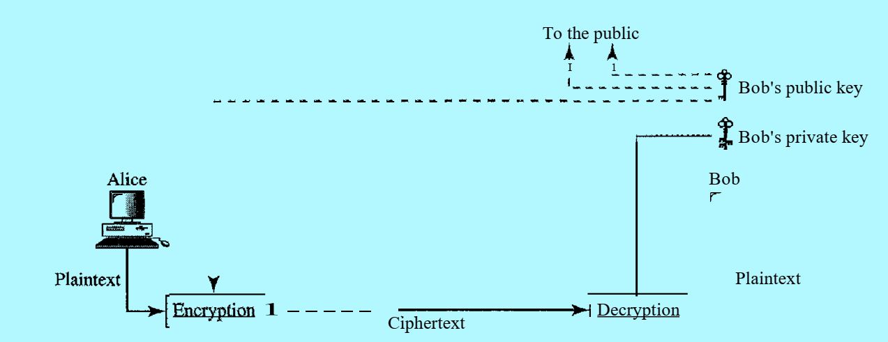
ASYMMETRIC KEY (PUBLIC-KEY)CRYPTOGRAPHY BLOCK DIAGRAM
<number>

Slide 19
RSA ALGORITHM (Rivest, Shamir and adleman)- example: GENERATING PUBLIC KEY
1. Choose two distinct prime numbers, p, and q.
2. Compute n = p*q .
3. Compute the totient of the product as λ(n) = (p − 1) * (q − 1).
λ(n) can also be, λ(n) = lcm(λ(p), λ(q)) = lcm(p − 1, q − 1).
4. Choose any number 1 < e < λ(n) that is coprime to λ(n), e.
Coprime: two integers a and b are said to be relatively, mutually or co prime if the only positive integer (factor) that divides both of them is 1 a, and b themself need not be prime.
Example 14, 15 are co prime, but they themself are not prime, only common divisor is 1.
( n , e ) is the Public key
<number>

Slide 20
RSA ALGORITHM- example: GENERATING PRIVATE KEY
5. Compute d, the modular multiplicative inverse of e (mod λ(n))
Inverse
Multiplicative
Modular
d * e mod λ(n) = 1
( n , d ) is the Private key.
<number>

Slide 21
RSA ALGORITHM- example: ENCRYPTION/ DECRYPTION
To encrypt, message m, into cipher c, c = ( m power e ) mod n
using public key (n, e) at sender
To decrypt, cipher text c to message m, m = ( c power d ) mod n
using private key, (n, d) at receiver
<number>

Slide 22
RSA ALGORITHM- example:
p = 3, q = 11, n = 33
λ(n) = (p − 1) * (q − 1) = (3-1)*(11-1) = 2*10 = 20
Choose any number 1 < e < λ(n) that is coprime to λ(n), e = 3
( n , e ), is the Public key = ( 33, 3 )
Compute d, the modular multiplicative inverse of e (mod λ(n))
d such that, d * e mod λ(n) = 1
d * e mod λ(n) = d * 3 mod 20 = 7 * 3 mod 20 = 21 mod 20 = 1
d = 7
( n , d ), is the Private key = ( 33, 7 )
<number>

Slide 23
RSA ALGORITHM- example:
To encrypt, message m to Cipher text c, c = ( m power e ) mod n
Consider m = 2 3 4 , say its b c d, b is 2, c is 3 and d is 4
c = ( m power 3 ) mod 33
c = ( 2 power 3 ) mod 33 = 8
c = ( 3 power 3 ) mod 33 = 27
c = ( 4 power 3 ) mod 33 = 64 mod 33 = 31
For message m = 2 3 4 , Cipher c = 8 27 31
<number>

Slide 24
RSA ALGORITHM- example:
To decrypt, cipher text c back to message m, m = ( c power d ) mod n
m = ( c power 7 ) mod 33
c = 8 27 31
m = ( 8 power 7 ) mod 33 = 2
m = ( 27 power 7 ) mod 33 = 3
m = ( 31 power 7 ) mod 33 = 4
For Cipher c = 8 27 31 , message m = 2 3 4
<number>

Slide 25
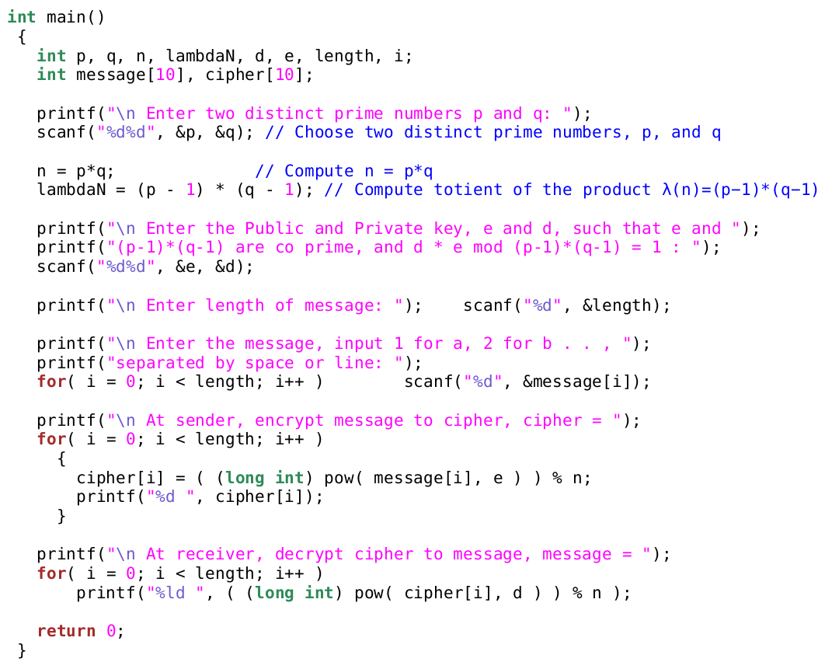
SOURCE CODE
<number>

Slide 27
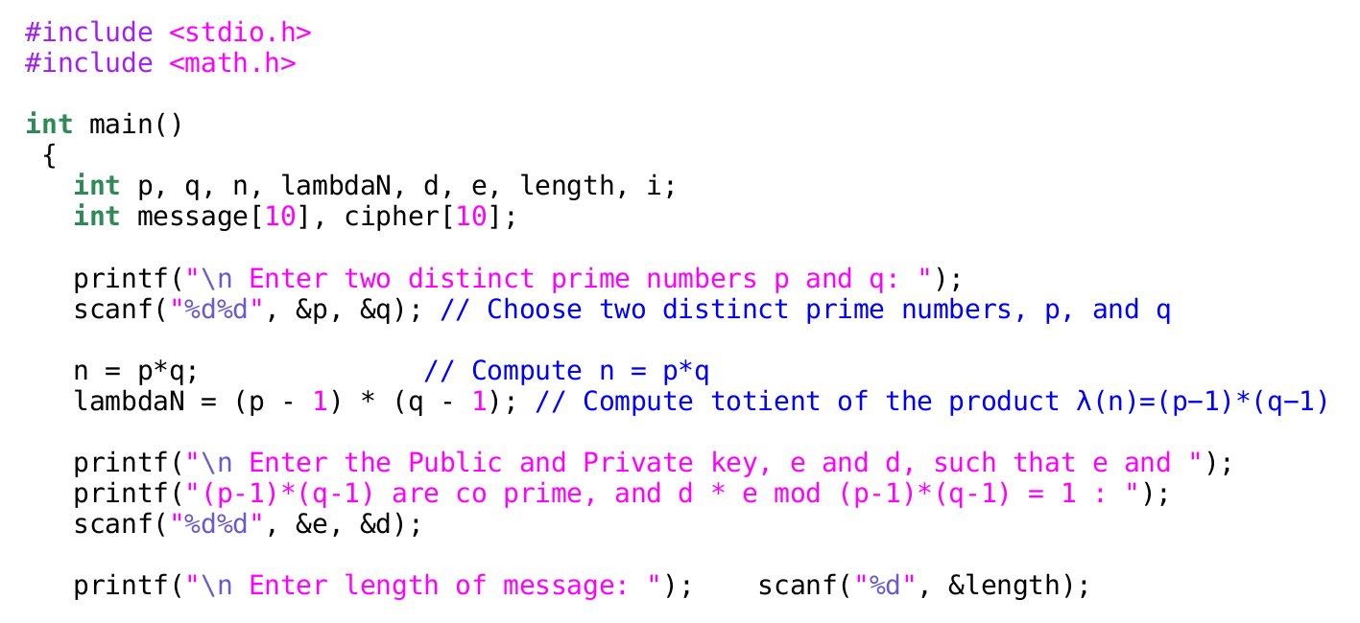

Slide 28
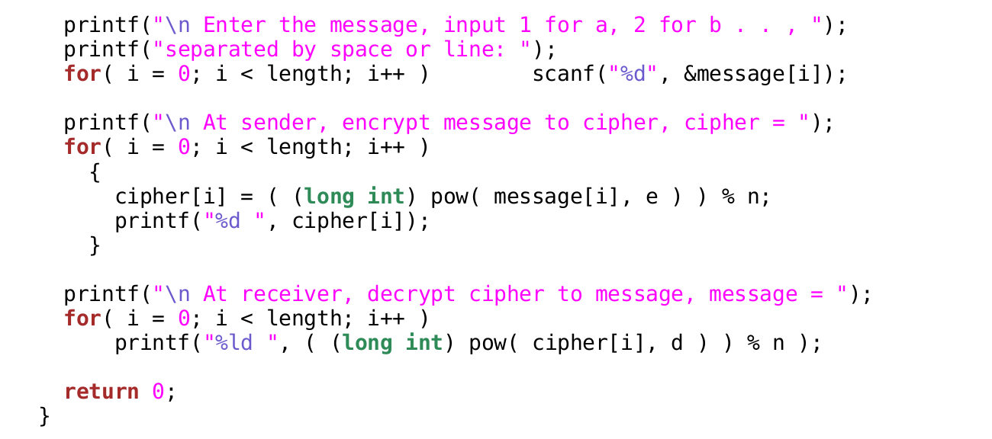

Slide 30
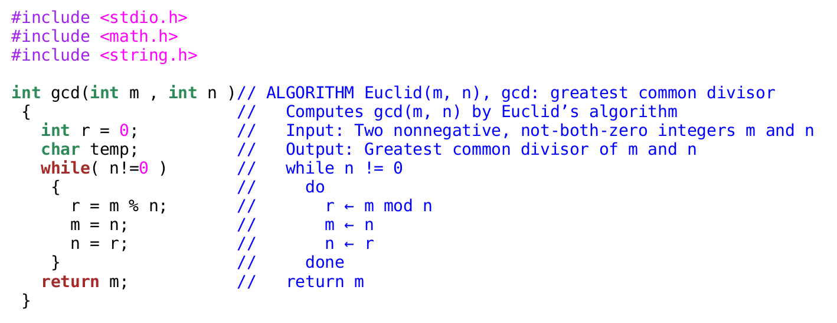

Slide 31
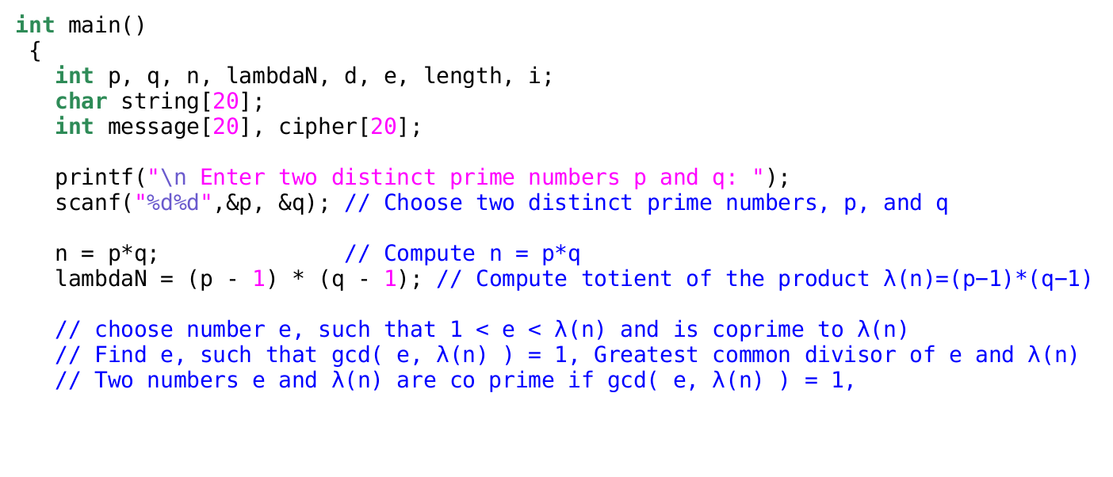
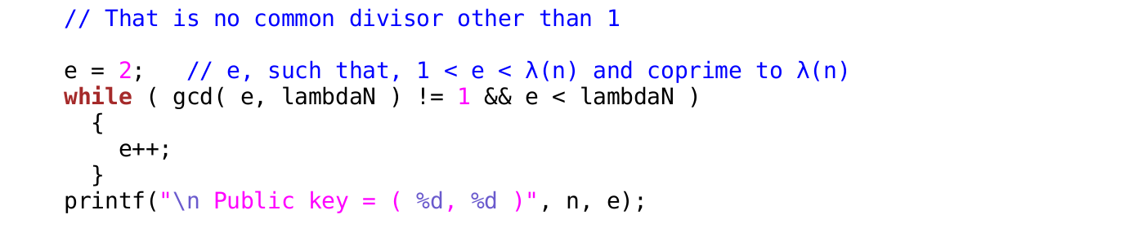

Slide 32
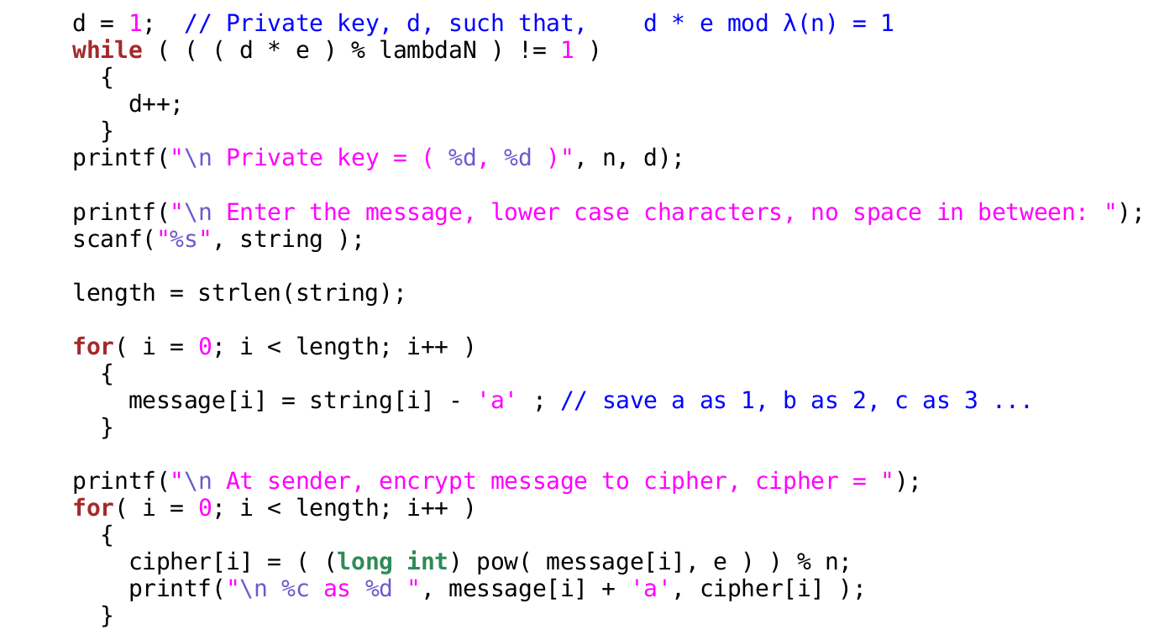

Slide 33
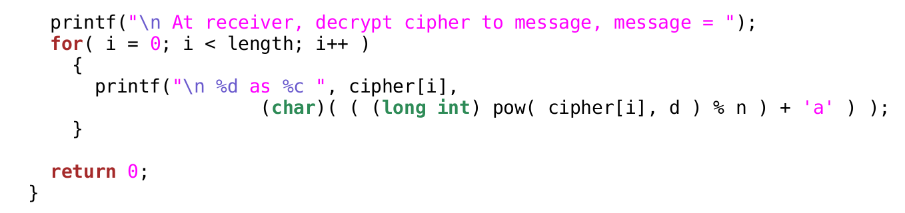
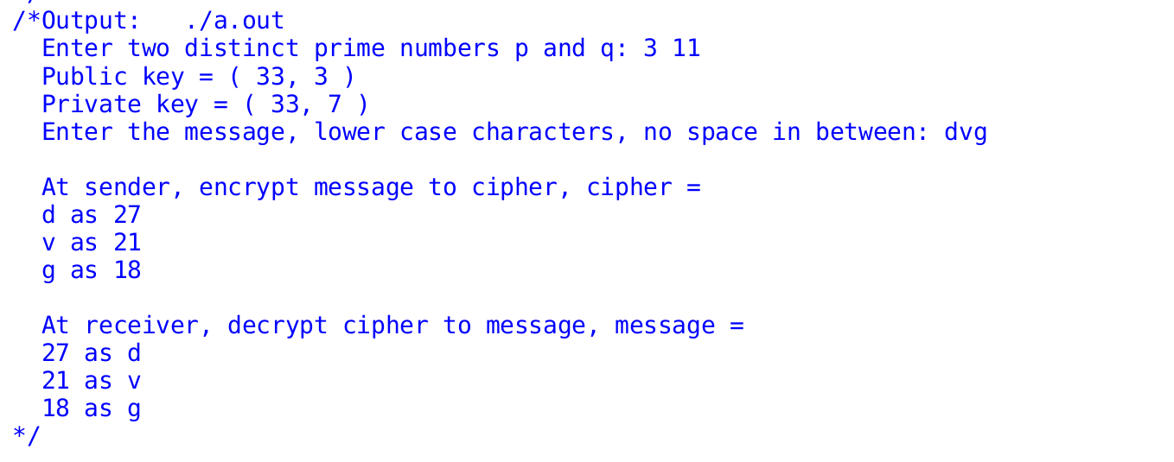

Slide 34
EXPECTED OUTPUT
case:1
Enter two distinct prime numbers p and q: 13 17
n=221;
Enter the Public and Private key, e and d, such that e and
(p-1)*(q-1) are co prime, and d * e mod (p-1)*(q-1) = 1: 35 11
Enter length of message: 3
Enter the message, input 1 for a, 2 for b . . , separated by space or line: 1 2 3
At sender, encrypt message to cipher, cipher = 1 59 61
At receiver, decrypt cipher to message, message = 1 2 3
<number>

Slide 35
EXPECTED OUTPUT
case:2
Enter two distinct prime numbers p and q: 3 11
n=33;
Enter the Public and Private key, e and d, such that e and
(p-1)*(q-1) are co prime, and d * e mod (p-1)*(q-1) = 1: 3 7
Enter length of message: 3
Enter the message, input 1 for a, 2 for b . . , separated by space or line:2 3 4
At sender, encrypt message to cipher, cipher =8 27 31
At receiver, decrypt cipher to message, message = 2 3 4
<number>

Slide 36
references
1. Behrouz Forouzon - Data Communications and Networking, McGraw Hill
Edition
2. Anany Levitin, Introduction to the design & analysis of algorithms
3. Thomas H. Cormen , Charles E. Leiserson , Ronald L. Rivest, Clifford Stein
Introduction to Algorithms
<number>

Slide 37
EXPECTED OUTCOME
Students will be able to implement RSA Algorithm to Encrypt and Decrypt data.

